Slide 1

A microgrid as a banking system based on the kWh
Dr. Paul Comet & John Ragsdale, Texas Transportation Institute, TAMU

Slide 2
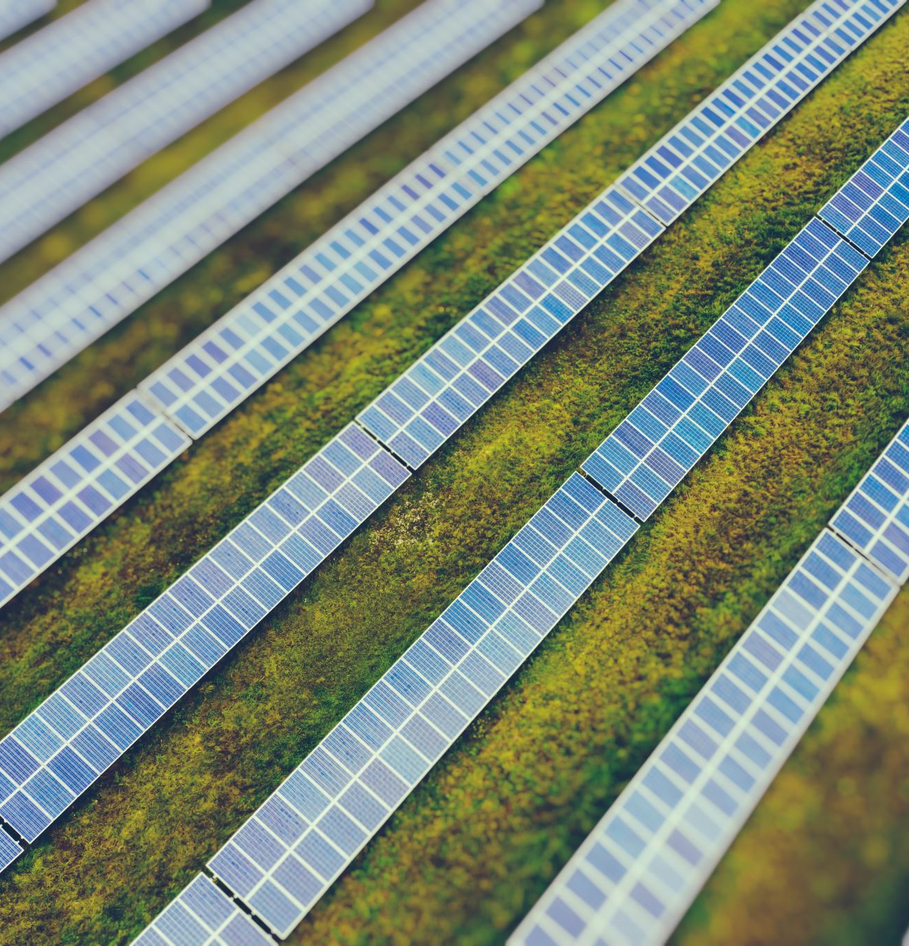
Using photovoltaic panels will generate an electric current. The kWh is currently sold for between 8 & 18 cents per kilowatt hour. To fit a home currently costs about $11,000 to $27,000 after tax credit (6-12 Kilowatts). 7 to 12 years to recover costs

Slide 3






2 ways of installing a microgrid. First, as an island, (not connected to the main grid). Secondly, connected to the grid.

Slide 4
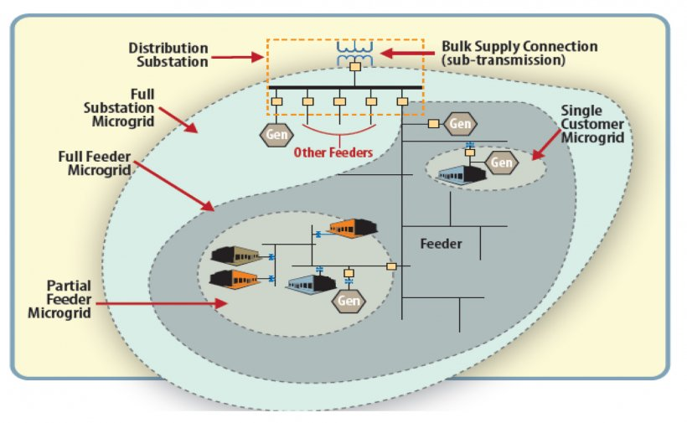
Taken from energy.gov

Slide 5
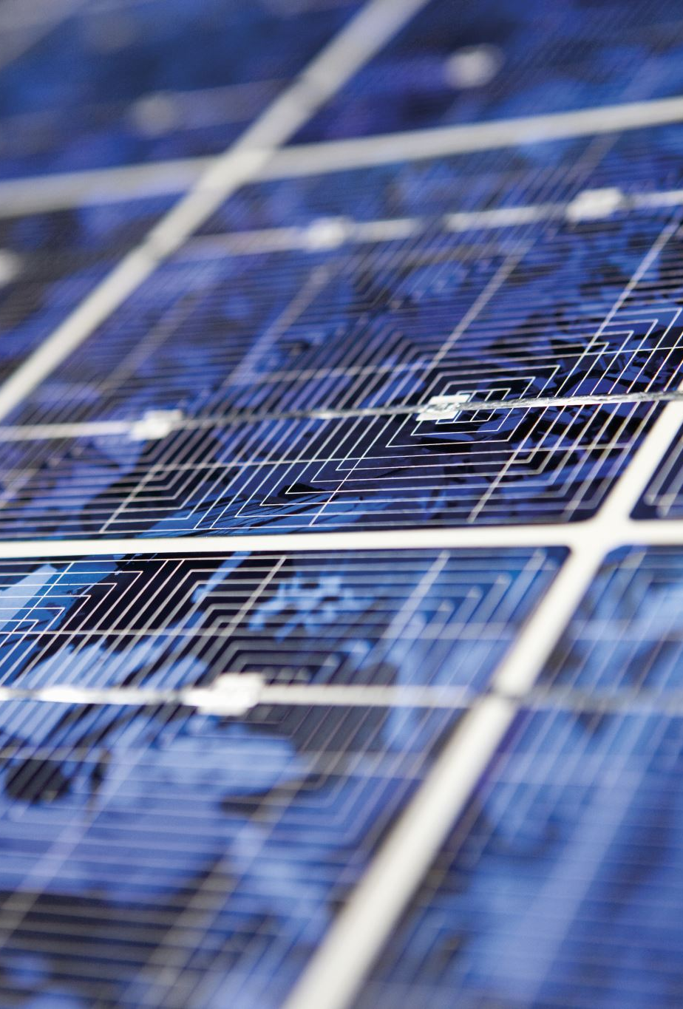
In island mode there is the problem of storage of electricity. Batteries are costly & bulky. However an electric car can be used as a storage device. Excess generation can be stored in other ways. Hence an island (disconnected) microgrid can be self sufficient if excess capacity is stored in a battery. So when the sun doesn’t shine (or the wind blow) then stored electricity can be accessed.

Slide 6

However if the microgrid has a connection to the regional grid, then surplus electricity can be downloaded to receive a credit. When there is insufficient energy in the microgrid then more electricity can be accessed by tapping into the regional grid.

Slide 7
The input of energy to the regional grid can secure credits denominated in kWh. Conversely accessing electricity from the main grid yields debits. I believe that the credits effectively act as money, perhaps by using a credit card system.

Slide 8

If the microgrid is fully independent of the regional grid, then surplus energy can be stored in other ways than batteries, e.g molten salt, hot sand, electrolytic hydrogen etc. These methods only store energy, they do not add to it. However if the surplus energy is used in the gasification of waste, the gas, now containing much more energy than originally input, can be stored in cylinders, and later combusted at times of low electrical input.

Slide 9
Waste can be used as fuel in a number of ways. It can be directly combusted for heat to turn a steam turbine(but problem of volatile metals and dioxins).
It can be anaerobically combusted to syngas (CO+H2).Unsure how many organohalides are formed(super greenhouse gases).
It can be steam reformed to H2 & CO2.
Can be pyrolyzed to “crude oil”.
Can be hydrogenated to “crude oil”.

Slide 10

An integrated, sustainable, system could be built, which uses “wasted” energy from the sun, to create stored energy that could be used at night or during cloudy days.

Slide 11

The credits generated, backed by renewable energy, could form the base of a banking system that serves a parallel economy run by alternative energy.

Slide 12
If the system “works” it could provide small rural towns with a sustainable, carbon neutral, economy. Possible analogies to the 3rd world, refugee camps and a lunar base.

Slide 13
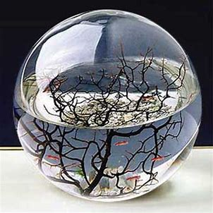
Courtesy of NASA

