Slide 1



Title Slide
Promoting Social Capital and Environmental Citizenship:
The Texas A&M-Chevron Engineering Academy: A Partnership Between Texas A&M, Dallas College, and Chevron

Slide 2
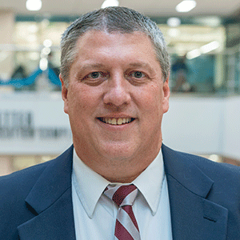
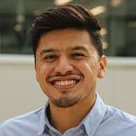
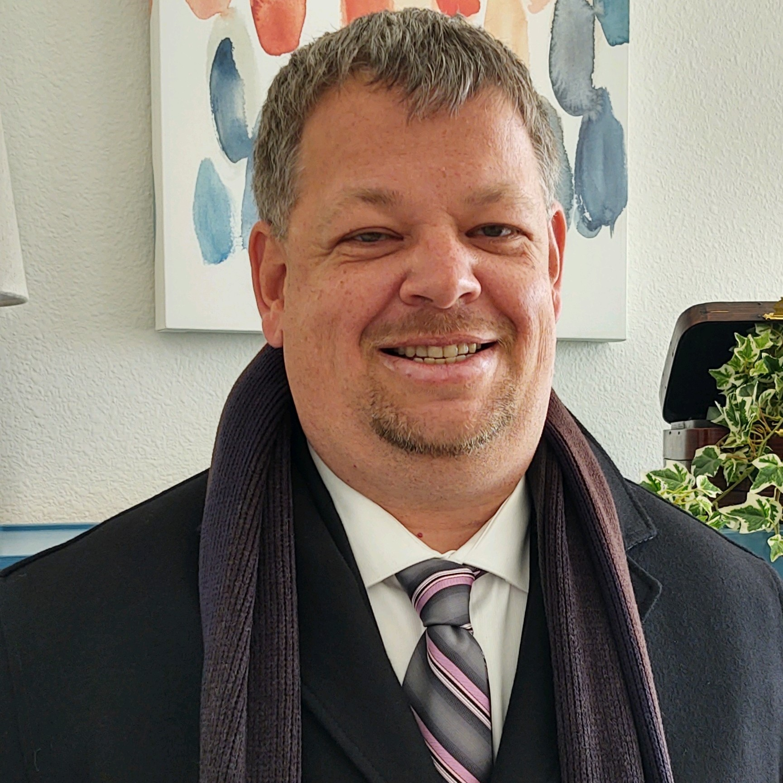
Contact Information
Ed Bassett
Director Texas A&M Engineering Academies
e.bassett@tamu.edu
Paul Onate
Dallas College Assistant Director
Engineering Academies
POnate@dallascollege.edu
Timothy Cedor, Ed.D.
Dallas College English Faculty
tcedor@dallascollege.edu

Slide 3


Session Objectives
1. Demonstrate how this partnership implements the seventeenth United Nations Sustainable Development Goal: “a successful sustainable development agenda requires partnerships between governments, the private sector and civil society. These inclusive partnerships are built upon principles and values, a shared vision, and shared goals that place people and the planet at the center, are needed at the global, regional, national, and local level” (UN, 2018).

Slide 4
Session Objectives
2. Demonstrate how this partnership creates “school partnerships with different actors [that] provide students with such authentic learning experiences related to real-world social and environmental issues in a critical way, and these experiences, in the wider social, political and business context, enable students to participate in a citizenry process that might improve social equity and justice” (Alkaher & Gan, 2020).

Slide 5
Promoting Social Capital
Promoting Social Capital:
Social network, trust and norms that can lead to improvement in economic efficiency through coordinated actions (Alkaher & Gan, 2020)

Slide 6

The Texas A&M Engineering Academies

Slide 7
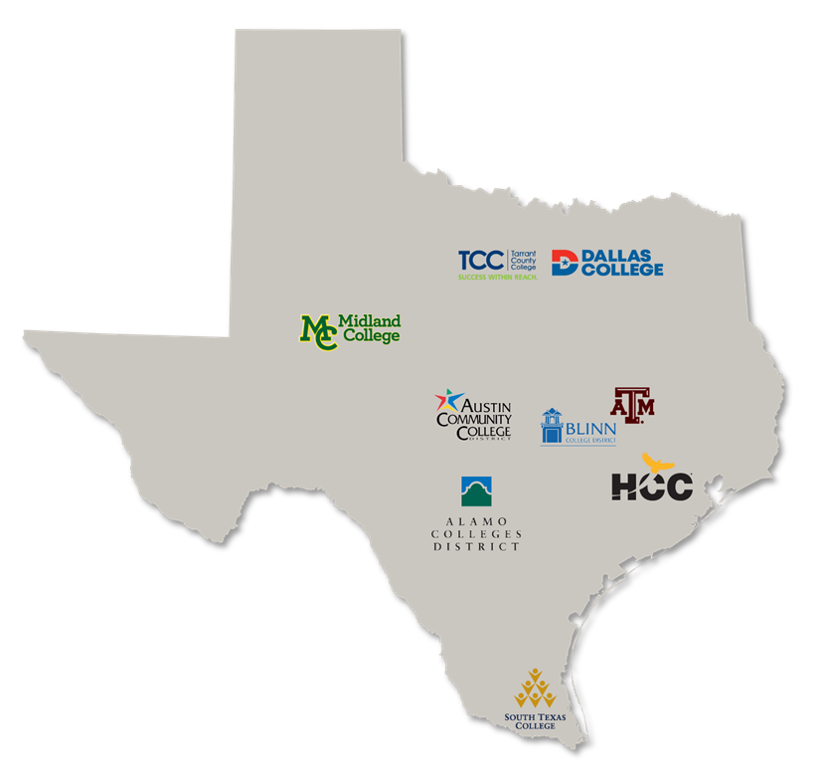
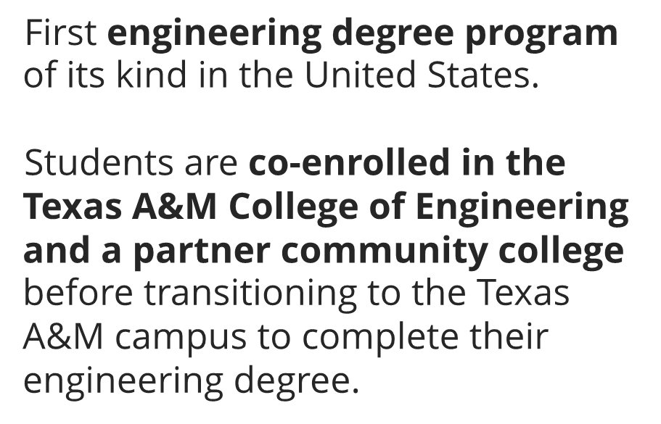
The Texas A&M Engineering Academies

Slide 8
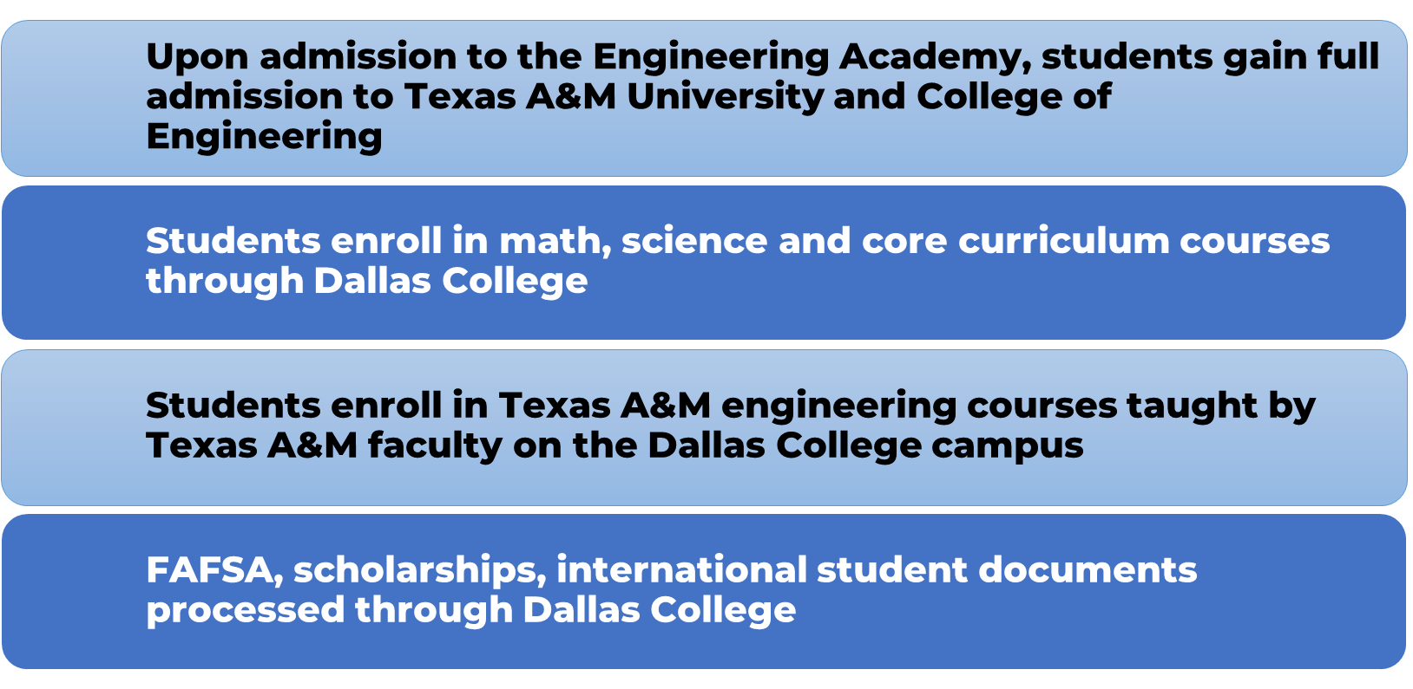
The Texas A&M Engineering Academies

Slide 9
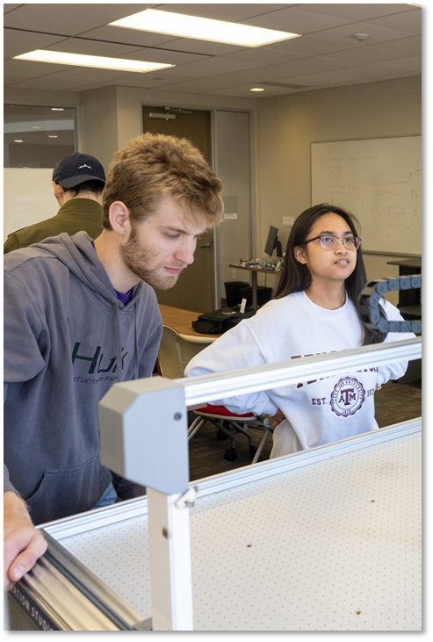
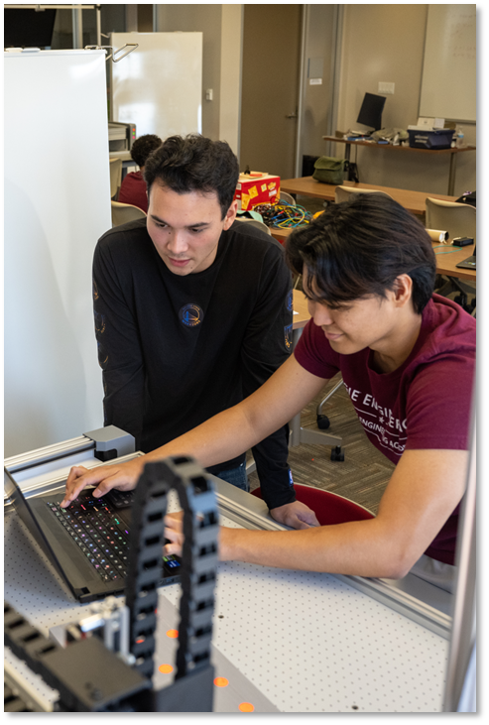

The Texas A&M Engineering Academies—Three Goals
Access
Affordability
Completion
Partnering with community colleges enabling students to progress.
Maximizing student services to make education more equitable.
Integrating student success programs to increase completion rates.

Slide 10
The Texas A&M/Dallas College Collaboration Efforts
Recruitment
Joint efforts at college fairs, high school visits, Dallas College math course visits,
informational sessions, campus visits/tours
Logistics
MOU agreement addressing items such as enrollment, financial aid, reverse transfer and
marketing signed by both institutions
Designated classroom and office space at Dallas College campus for TAMU courses, faculty
and staff
Marketing
Engineering Academies dedicated marketing budget for all partners
Dallas College Marketing Office - social media and advertisement campaigns to help increase
recognition and enrollment

Slide 11
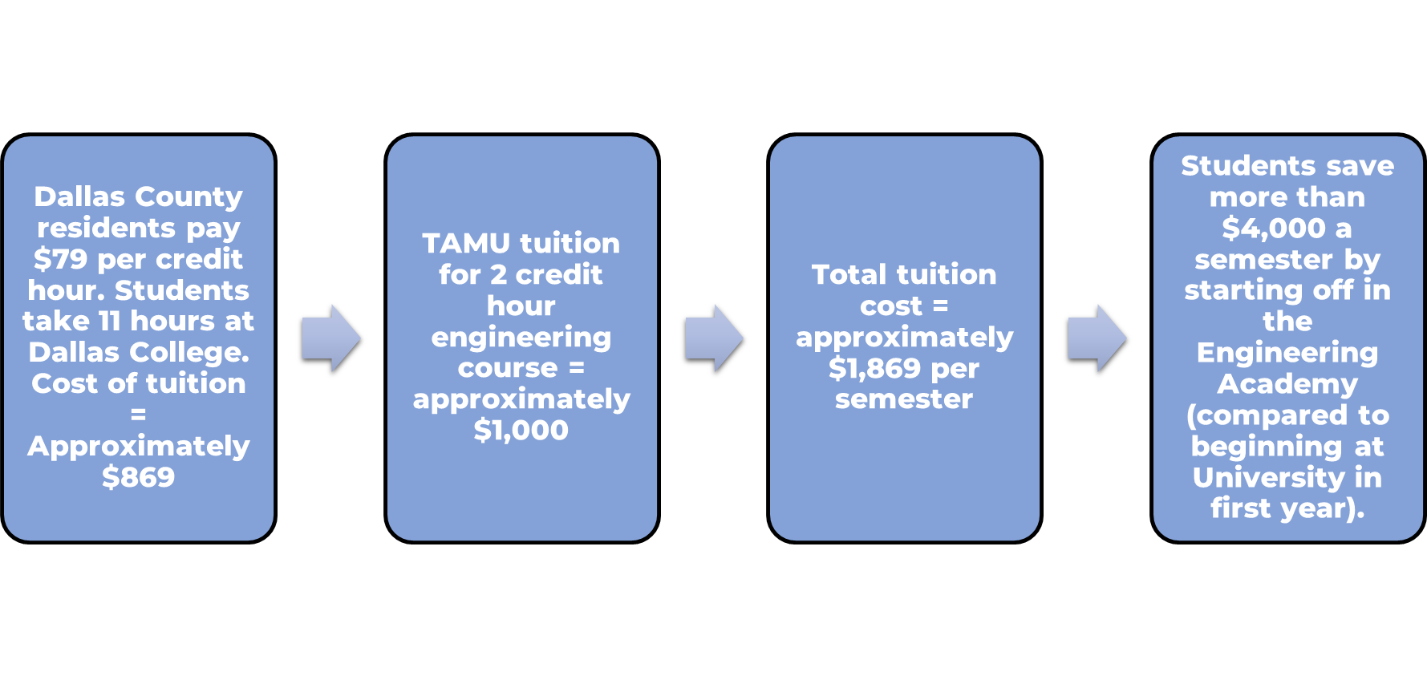
The Dallas College Academy

Slide 12
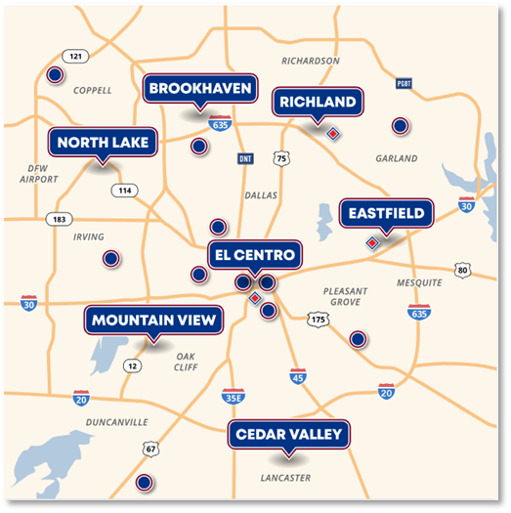
The Dallas College Academy

Slide 13
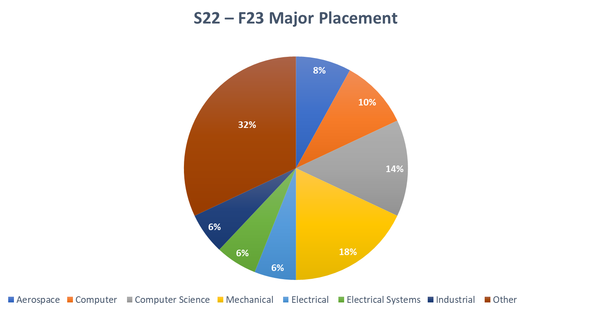
The Dallas College Academy
90% retention rate between fall 2022 and spring 2023
88% of students in Dallas Engineering Academy received their 1st choice major
70% of engineering academy students (all locations) received their 1st choice major

Slide 14
Promoting Environmental Capital
Promoting Environmental Capital:
“…the motivation, self-confidence, and awareness of one’s values, and the practical wisdom and ability to put one’s civics and ecological literacy into action” (Berkowitz et al., 2005, p. 228)

Slide 15
Overview: ENGL 2311 Technical Writing
The course is only open to Dallas College students enrolled in the Engineering Academy. Paul is the gate keeper to course
enrollment, and I work with Rebecca Suratt (program specialist, recruiter, advisor) when students are struggling academically.
I collaborated with Texas A&M technical writing professors and modeled the course after their courses, but I modified this one specifically for engineers.
I contacted three engineers in the DFW area, told them about the program and the course, and they helped me create two assignments for this course that promote environmental capital while meeting the requirements Texas A&M expects of students who take technical writing on their main campus.

Slide 16
Course Projects
Ethics Paper Assignment
The Engineer’s Code of Ethics encourages engineers to adhere to the principles of sustainable development in order to protect the environment and future generations. Address an ethical dilemma in engineering impacting the environment and make a case that your ethical decision is the right decision.
Example Projects
The ethics of John Deere’s decision to make themselves the only people able to modify/work on the software installed on their tractors or your warranty is voided.
The ethics of geoengineering (deliberate manipulation of climate system) to counteract global climate change.

Slide 17
Course Projects Continued
Collaborative Report Assignment
Your group needs to research a recent engineering development from the list below. You will collaboratively write an engineering report explaining this advancement to me (a customer, community, business, or investor) showing me how this invention impacts the environment.
Example Projects
Alternative uses of the diamond
How thermoelectric generators work
Modern tendencies in tissue engineering
Limits of genetics engineering

Slide 18
Contact Information
Ed Bassett
Director Texas A&M Engineering Academies
e.bassett@tamu.edu
Paul Onate
Dallas College Assistant Director Engineering Academies
POnate@dallascollege.edu
Timothy Cedor, Ed.D.
Dallas College English Faculty
tcedor@dallascollege.edu

Slide 19
References
Alkaher, I. & Gan, D. (2020). The role of school partnerships in promoting education for
sustainability and social capital. The Journal of Environmental Education, 51(6), 416-433.
https:doi.org/10.1080/00958964.2020.1711499
Berkowitz, A. R., Ford, M. E., & Brewer, C. A. (2005). A framework for integrating ecological
literacy, civics literacy, and environmental citizenship in environmental education. In E. A.
Johnson & M. J. Mappin (Eds.), Environmental education and advocacy, 227–266.
Cambridge: Cambridge, University Press.
UN. (2018). About the sustainable development goals. Retrieved from
https://www.un.org/sustainabledevelopment/ sustainable-development-goals

