Slide 1

Intersectional Environmentalism & Climate Justice
Jessica R. Murfree, PhD
Benika C. Dixon, DrPH
Texas A&M University

Slide 2


Challenges
First addressing DEI in sport organizations
Then applying justice-based issues
Requires understanding the gaps in the composition and mission of the organization and its community
Climate and environmental injustices compound for historically marginalized communities

Slide 3



Activity
Using your paper, create and fold a paper airplane

Slide 4

How diverse is your org.?
Greater Community
Who is your community?
  Ethnicity
  Socio-economic
  Capabilities
  Gender
  Physical and Mental Health
Ticket Holders, Consumers, Subscribers
Front
Office, Staff, Athletes

Slide 5
How diverse is your org.?
  1
  2
  3
Is your organisation reflective of your community? Is your fan base reflective of the global majority?
Does your work impact your community and what are the environmental impacts on them?
Is your community directly affected currently or will they be affected in the near future?

Slide 6









What issues and barriers are sport organizations facing in DEI efforts?
Read more here!

Slide 7


"In far too many ways, Black people were the natural resources exploited for profit, just like fossil fuels are today. Worse still: It never stopped."
Mary Annaïse Heglar
Columbia Climate School

Slide 8

“Sport organizations must begin to see climate and our ecosystems as an issue that perpetuates marginalization in disparate communities.”
Ajhanai Keaton, PhD
University of Louisville

Slide 9

“Climate change is intrinsically linked to public health, food and water security, migration, peace, and security. It is a moral issue. It is an issue of social justice, human rights and fundamental ethics. ”
Ban Ki-moon
Former UN Secretary-General

Slide 10
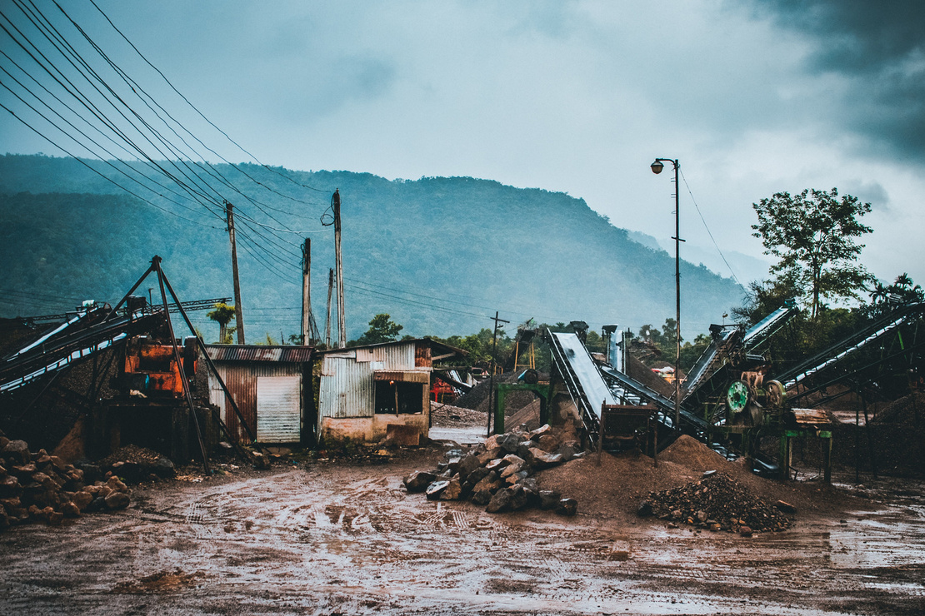
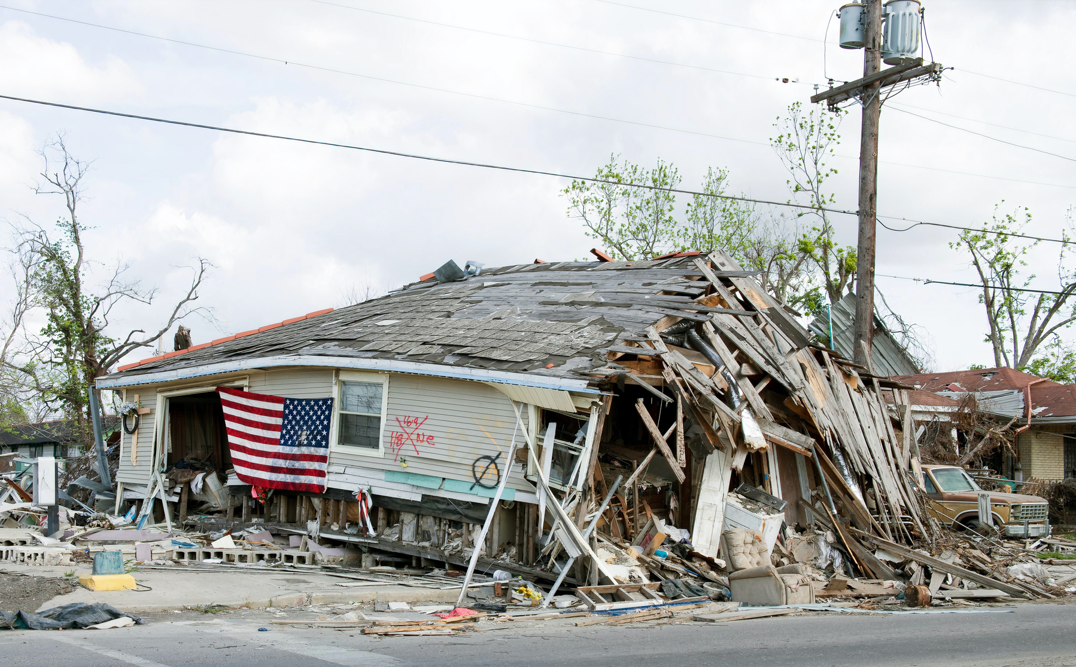
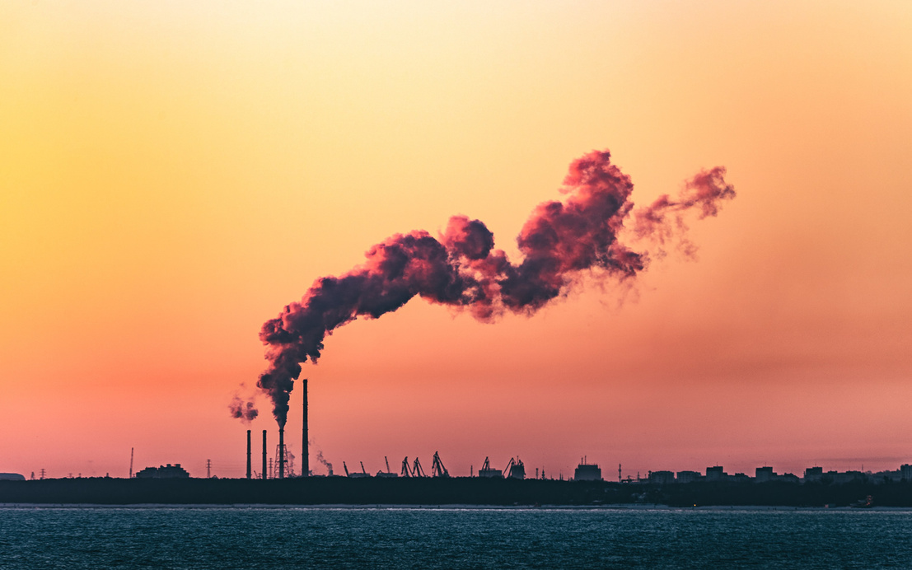
Activity
Now, consider the effects of environmental and climate injustices on your planes

Slide 11
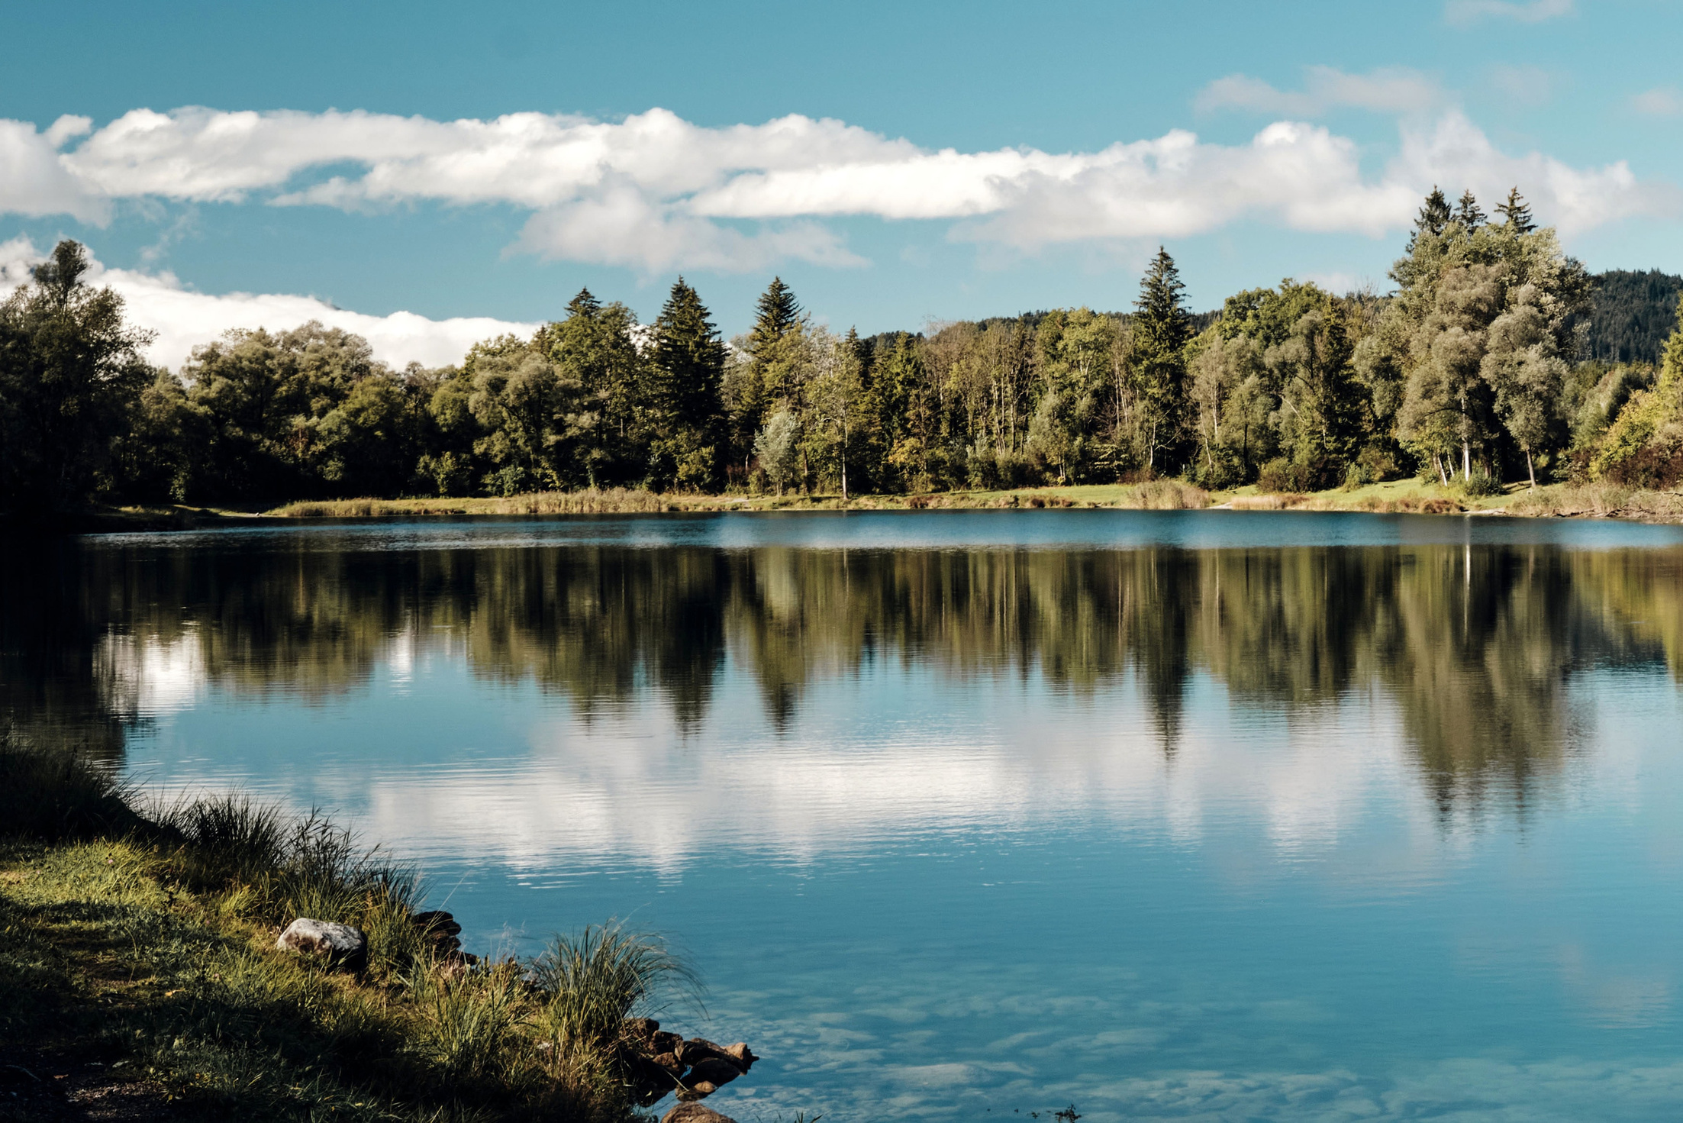

ENVIRONMENTAL (IN)JUSTICES
CLIMATE (IN)JUSTICES
Access to clean air, water ,soil & energy
Proximity to healthy food options, safe green spaces
Life free from toxic waste, pollution, & hazardous materials
Exposure to climate hazards Intergenerational economic challenges
Socio-economic instability Disproportionate forced resiliency
Quality of life & satisfaction
Birth & mortality rates
Education, professional, & wealth opportunities
Physical/mental health & wellbeing Healthcare access
Normalized environmental racism,
sexism, genderism, & ableism Displacement of community Forced community resiliency and livability (social cohesion)

Slide 12
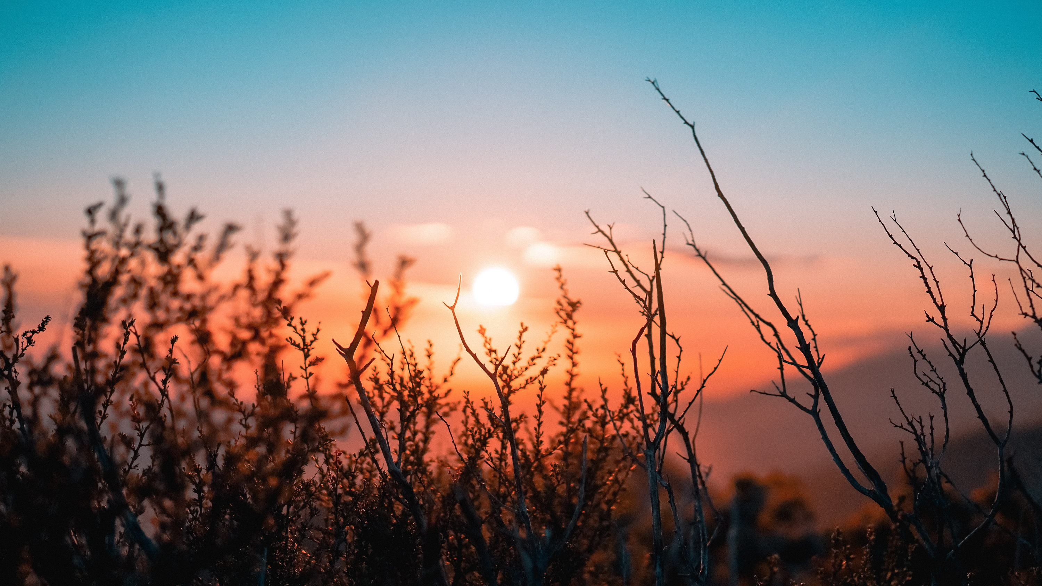
Climate Change Outcomes
Effects of Climate Change
Interventions & Strategies
Health Impacts
  Extreme heat
  Air & water pollution
  Reduced food/water quality
  Changes in infectious diseases
  Increasing allergens
  Heat-related illness
  Chronic conditions
  Injuries & death
  Mental & neurological disorders (solastalgia)
  Zoonotic, vector, and waterborne diseases
  Respiratory diseases & asthma
  Early warning & preparedness
  Prevention or reduction of disease, illness, & injury
  Community engagement
  Education & awareness
  Adoption & integration of all of the above

Slide 13





Challenge the term sustainability
Outcome 1:
Assess organizational composition
Critique Policy and Pledges
Do pledges
lead to action?
Yes Evaluate
No
Eliminate

Slide 14
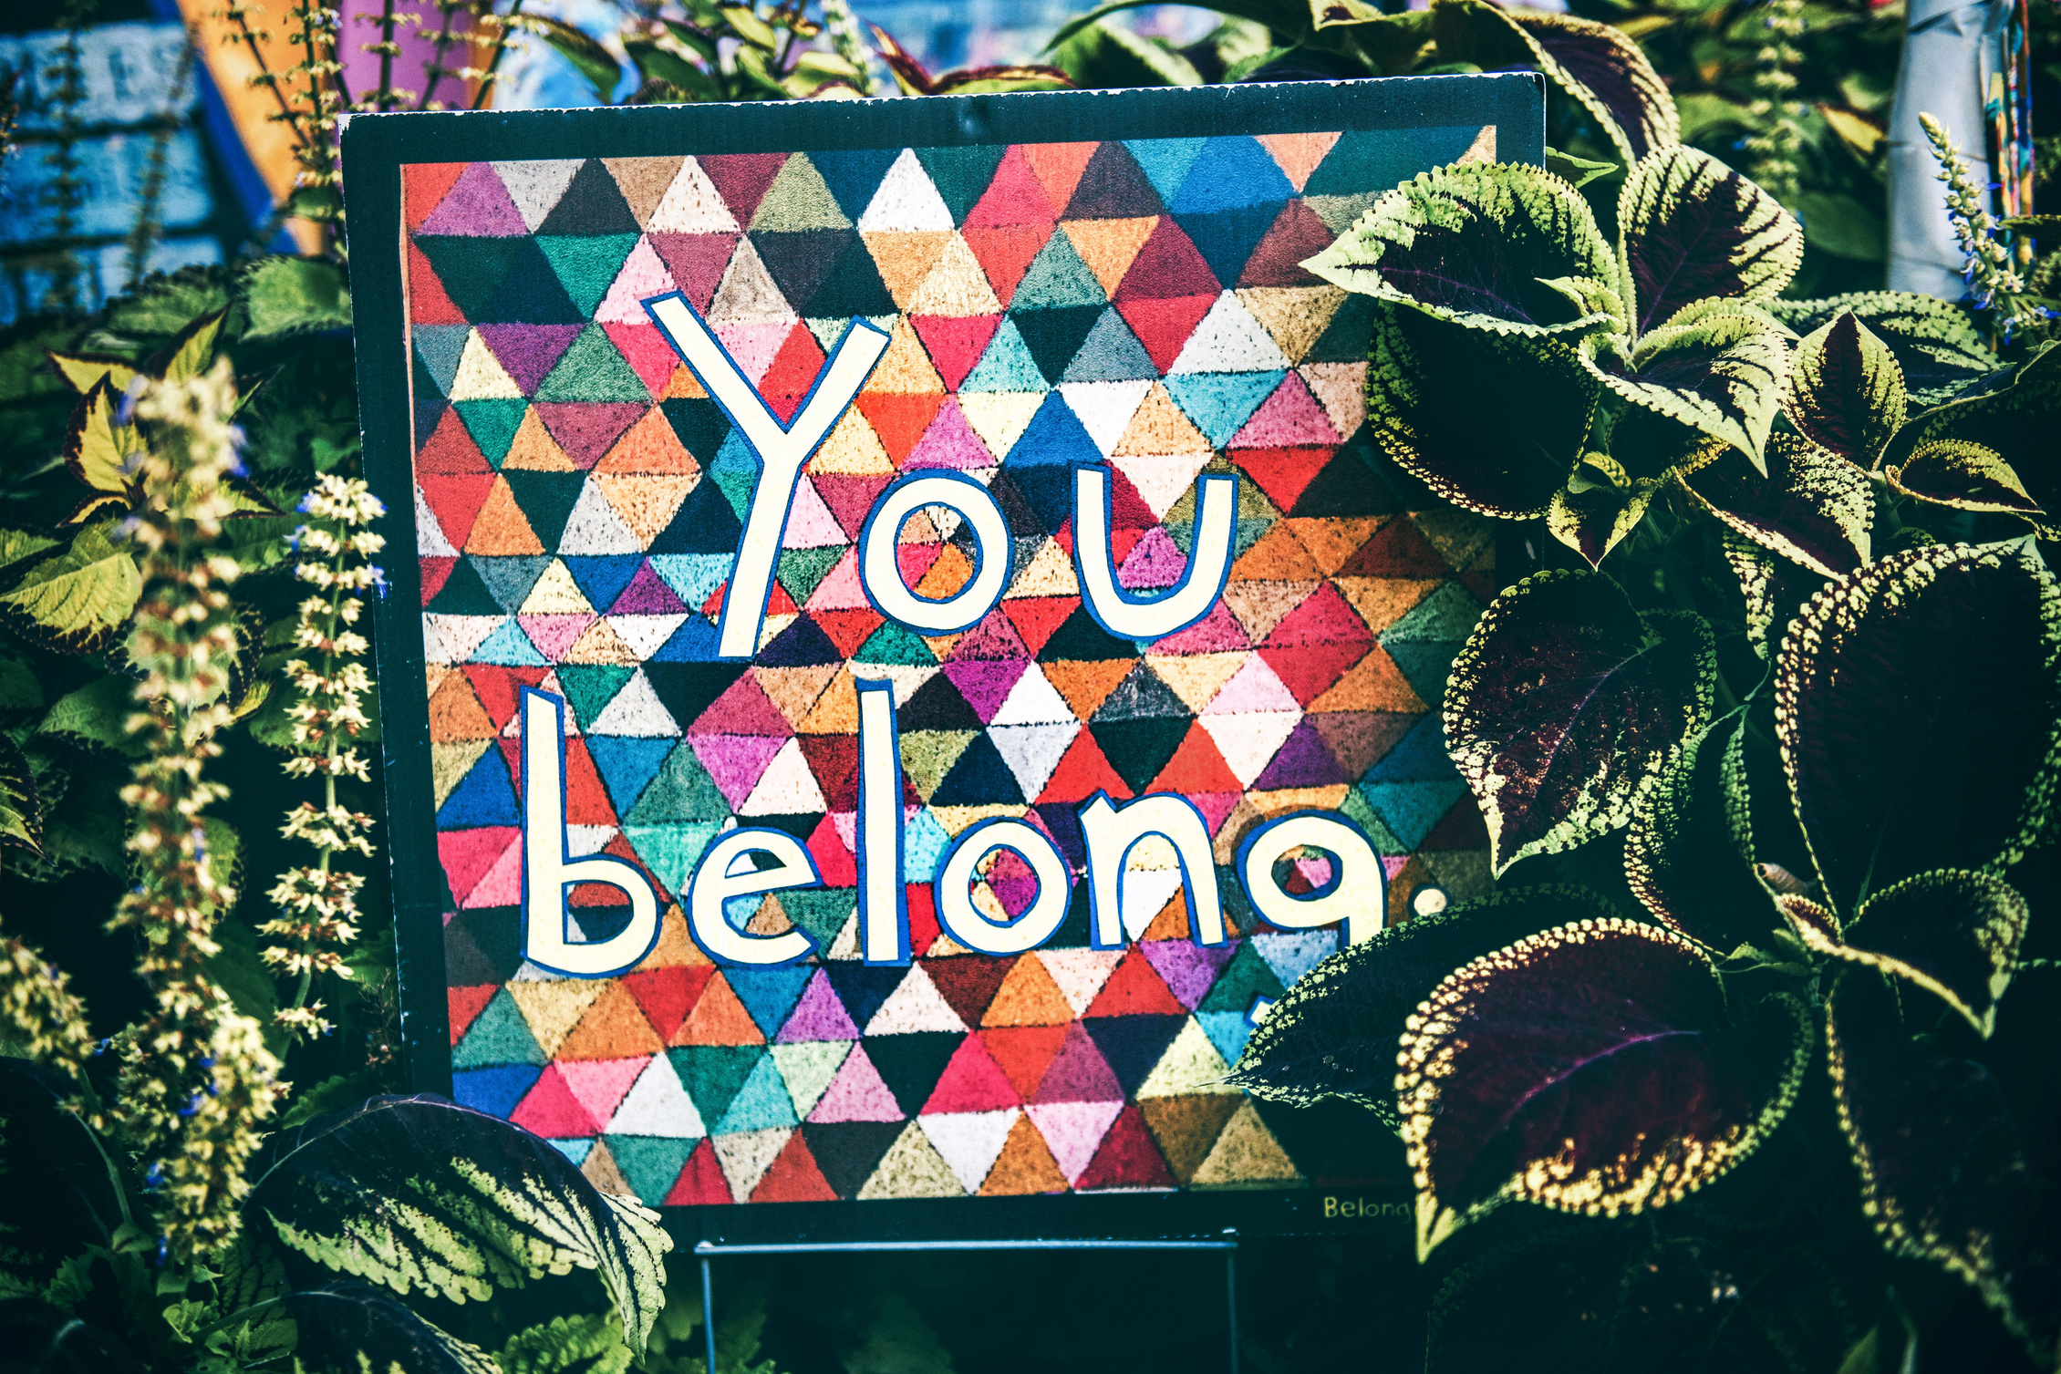

Outcome 2:
Utilize Mindful Language to Create Environmentally Inclusive Spaces

Slide 15
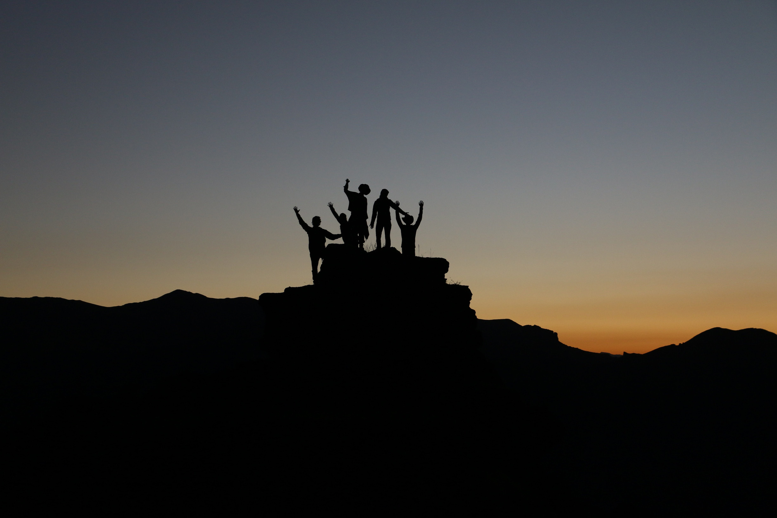
Outcome 3:
Employ Cultural and Ecological Empathy at Every Level of Operation

Slide 16



Resources
Accessible resources and references that:
  Amplify voices of intersectional environmental and climate justice workers
  Support BIPOC, LGBTQ+, & Disability communities
  Illustrate relationships between climate, environmental justice, health & sport

